Slide 1

Conditional Statements

Slide 2
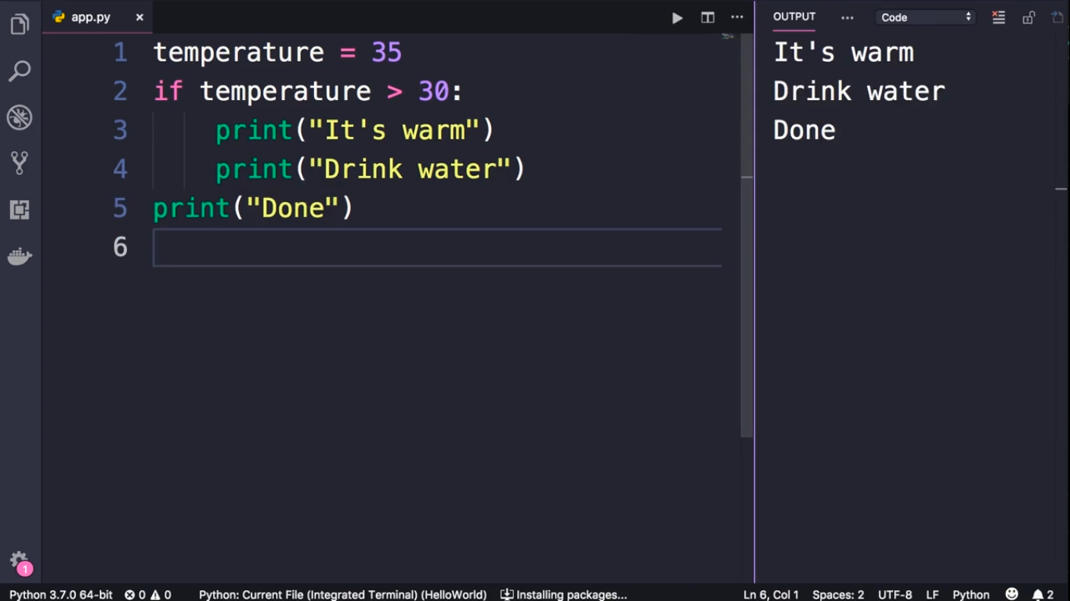

Slide 3
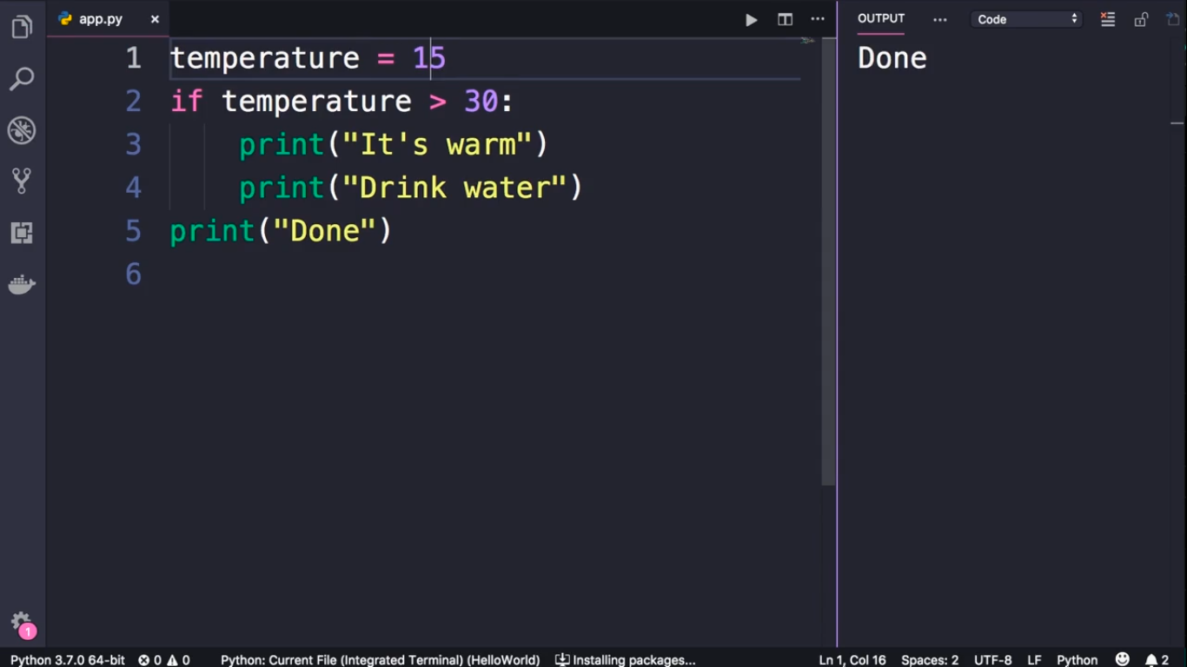

Slide 4
